Slide 1
UNIT 1: MY FRIENDS
READ

Slide 2
I.Vocabulary
Generous
Sociable= Out going
Humorous
Character
Helpful
Reserved
Shy
Kind

Slide 3
Ba is talking about his friends.
I am lucky enough to have a lot of friends. Of all my friends, Bao, Khai, Song are the ones I spend most of my time with. Each of us, however, has a different character.
Bao is the most sociable. He is also extremely kind and generous. He spends his free time doing volunteer work at a local orphanage, and he is a hard-working student who always gets good grades.
Unlike Bao, Khai and Song are quite reserved in public. Both boys enjoy school, but they prefer to be outside the classroom. Song is our school’s star soccer player, and Khai likes the peace and quiet of the local library.
I am not as outgoing as Bao, but I enjoy telling jokes. My friends usually enjoy my sense of humor. However, sometimes my jokes annoy them.
Although we have quite different characters, the four of us are very close friends.

Slide 4
I.Vocabulary
character ( n ) :
sociable ( a ) = out going :
generous ( a ) :
reserved ( a ) :
humor ( n ):
extremely ( adv ) :
orphanage ( n ) :
orphan (n):
peace ( n ) :
jokes ( n ) :
annoy ( v ) :
affect ( v ) :
get tired of ( v ) :
tính cách
chan hoà , hoà đồng
rộng lượng, háo phóng
dè dặt , kín đáo
tính hài hước
rất, cực kỳ
trại mồ côi
trẻ mồ côi
hoà bình , yên bình
chuyện đùa ,lời nói đùa
làm khó chịu, bực mình
ảnh hưởng
chán

Slide 5
Ba is talking about his friends.
I am lucky enough to have a lot of friends. Of all my friends, Bao, Khai, Song are the ones I spend most of my time with. Each of us, however, has a different character.
Bao is the most sociable. He is also extremely kind and generous. He spends his free time doing volunteer work at a local orphanage, and he is a hard-working student who always gets good grades.
Unlike Bao, Khai and Song are quite reserved in public. Both boys enjoy school, but they prefer to be outside the classroom. Song is our school’s star soccer player, and Khai likes the peace and quiet of the local library.
I am not as outgoing as Bao, but I enjoy telling jokes. My friends usually enjoy my sense of humor. However, sometimes my jokes annoy them.
Although we have quite different characters, the four of us are very close friends.

Slide 6
Word forms
1. socialize (v): giao tiếp
→ sociability (n): tính hoà đồng
→ sociable (a.) ≠ unsociable : hoà đồng
- social (a.) : có tính chất xã hội
→ sociably (adv.) : một cách chan hoà
2. generous (a.) → genererosity (n) :tính rộng lượng
3. humor (n) : tính khôi hài → sense of humor : óc khôi hài
→ humorous (a.)
4. peace (n) : hoà bình
→ peaceful (a.): thanh bình
→ peacefully (adv.): một cách thanh bình
5. extreme (a.) : cực kỳ
→ extremely (adv.): vô cùng
6. lucky (a.) ≠ unlucky : may mắn
→ luckily (adv.) ≠ unluckily

Slide 7
7. appear (v) ≠ disappear : xuất hiện
→ appearance (n) : sự xuất hiện
8. enjoy (v)
→ enjoyment (n) : sự vui vẻ
→ enjoyable (a.) : vui, thú vị
→ enjoyably (adv.) : một cách thú vị
9. volunteer (v) : tình nguyện
(n) : người tình nguyện
→ voluntary (a.) : tự nguyện, tự ý
→ voluntarily (adv.)
10. annoy (v) : làm cho bực mình
→ annoyance (n): sự bực bội
→ annoying (a.) : gây bực bội
annoyed with sb. (a.): bực mình với ai
annoyed at / about sth. : bực mình việc gì

Slide 8
11. straighten (v) : làm cho thẳng
→ straightness (n) : sự thẳng thắn
→ straight (n) : chỗ thẳng, đoạn thẳng
→ straight (a.) : thẳng (adv.) : thẳng
straightforward (a.) : thẳng thắn, chân thực
12. curl (v): uốn, cuộn
(n) : cuộn, xoắn
→ curly (a.) : quăn, xoắn

Slide 9
I. Vocabulary
II. Mutiple choice

Slide 10
a. Ba talks about_______ of his friends .

A
three
x
B
all
x
C
four
x
D
none
What a pity, you are wrong
Bravo, you are right

Slide 11
b. Bao’s volunteer work _________.

A
does not affect his school work
x
B
helps him make friends
x
C
takes up a lot of time
x
D
causes problems at exam time
What a pity, you are wrong
Bravo, you are right

Slide 12
c. Khai and Song _________ .
x
A
like quiet places
x
B
enjoy sports
x
C
dislike school

D
don’t talk much in public
What a pity, you are wrong
Bravo, you are right

Slide 13
d. Ba’ friends sometimes ______ his jokes.
x
A
answer
x
B
laugh at

C
get tired of
x
D
do not listen to
Bravo, you are right
What a pity, you are wrong

Slide 14
I.Vocabulary
II.Multiple choice
III.Answer the questions

Slide 15
III.Answer the questions
a) How does Ba feel having a lot of friends ?
b) Who is the most sociable ?
c) Who likes reading ?
d) What is a bad thing about Ba’s jokes ?
e) Where does Bao spend his free time ?
f) Do you and your friends have the same or different character ?

Slide 16
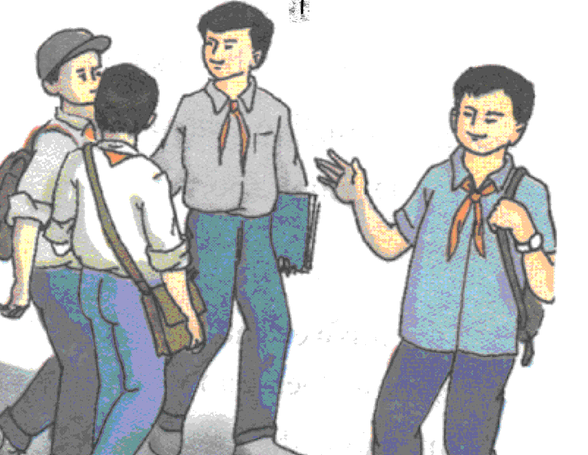
III.Answer the questions
a) How does Ba feel having a lot of friends?
→ He feels lucky enough to have a lot of friends.

Slide 17
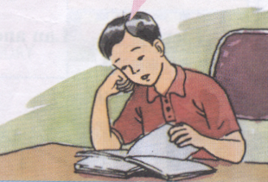
III.Answer the questions
c) Who likes reading?
→ Khai likes reading.

Slide 18
III.Answer the questions
d) What is a bad thing about Ba’s jokes?
→ They sometimes annoy his friends. (Ba’s jokes)

Slide 19
III.Answer the questions
b) Who is the most sociable?
→ Bao is the most sociable.

Slide 20
III.Answer the questions
e) Where does Bao spend his free time?
→He spends his free time doing volunteer work at a local orphanage.

Slide 21
III.Answer the questions
f) Do you and your friends have the same or different character ?
We have the same characters
( We have quite different characters )

Slide 22
III.Answers
a) He feels lucky enough to have a lot of friends.
b) Bao is the most sociable.
c) Khai likes reading.
d) They sometimes annoy his friends.
e) He spends his free time doing volunteer work at a local orphanage.
f) We have the same characters.
( We have quite different characters )

Slide 23
Grammar and structures:
Talking about other’s characters.
Ex: What is Bao’s character?
What is Bao like?
He is sociable, kind and generous.
Formation:
What is + sở hữu + character?
= What is + S + like?
S + am/is/are + tính từ chỉ tính cách

Slide 24
I.Vocabulary
II.Multiple choice
III.Answer the questions
IV. Post -reading

Slide 25
* Talking about Ba’s friends :
IV. Post -reading
Song Khai Bao
-reserved
-enjoys school
-a school’s star soccer player
. reserved
. enjoys school
.likes reading
- sociable,
- kind, generous
- a volunteer
- a hard-working student

Slide 26
V. Homework
Do exercises
Learn new words by heart
Prepare : Write

Slide 27
I. PRONUNCIATION
A. 1. orphanage joke owner gramophone
2. character attraction satellite veteran
3. straight fair classmate awake
B. 4. generous reserved sociable curly
5. annoy defeat perform gather
I. Choose the most appropriate word or phrase...
6. That singer is tall and _________ .
short long slim straight
7. It is not polite to _________ her.
orphan annnoy joke straighten
orphanage
veteran
fair
reserved
gather
slim
annnoy

Slide 28
generous
8. We like Mary very much because she’s very ______.
blond curly reserved generous
9. A lot of young people have volunteered _______ social activities. ( in at for about)
10. Our neighbors always show _________ .
character sociability volunteer annoyance
11. It is funny to tell ___________.
cartoons jokes stories albums
12. Our parents always behave _________ toward us.
generously finally completely generally
13. Cyril and Dean helped those street children ______ .
skillfully normally moderately voluntarily
for
sociability
jokes
generously
voluntarily

Slide 29
14. Ms. Carla’s students are really _________
straight blond fair straightforward
15. That boy has short _______ hair.
slim curly tall oval
16. He is a natural ________. His hair is pale gold in color. (straight blond fair color )
17. Genererosity is part of the Vietnamese _________ .
joke orphanage character straightness
18. Julian has long __________ hair.
full fair slim thin
19. A home for children whose parents are dead is a(n) ________ . ( aquarium orphanage resort region)
straightforward.
curly
blond
character
fair
orphanage

Slide 30
20. He is unwilling to show his feelings. He is ______
sociable reserved generous straightforward
reserved.
Word forms
1. My friend Mai enjoys doing ______ work. (society)
2. Green Summer Campaign is a very popular __________ activity. (volunteer)
3. The noise from next door is so ________. (annoy)
4. I __________ my tie and walked in. ( straight )
5. Thank you for your _________ behavior. (generosity)
social
voluntary
annoying
straightened
generous

